Slide 1

Welcome to Online Quiz System Project Presentation

Slide 2
Supervised By
Nazrul Islam
Assistant Professor
Dept. of Information & Communication Technology, MBSTU.

Slide 3

Developed By
Name | ID
Mahbuba Zaman Mitu | IT-16044
Nadira Islam | IT-17051
Md Alamin | IT-16045
Hillol | IT-15025
Nayeem | IT-17052

Slide 4

Introduction

Slide 5
Cont..
Online Quiz System provides a common platform to connect student and teacher in online.
The registered teacher can create Quiz and student can take quiz and can asses himself/herself.

Slide 6
Features
Fully Functional Testing Environment
View graded results & selected answers instant
Remaining data privately in account
Unlimited Quizzes & Questions
Question bank
Security (HTTPS)
Set return links to website on completion

Slide 7
Tools
1. Language:
HTML
JavaScript
JSP
JDBC
Bootstrap Theme
2. Apache Tomcat server
3. Glassfish Server
4. MySQL Database

Slide 8
1. All information details are stored in files on stable storage. 2. To store all the information. 3. To secure the internal database. 4. For doing work more accurately.
Scope Of The Project

Slide 9
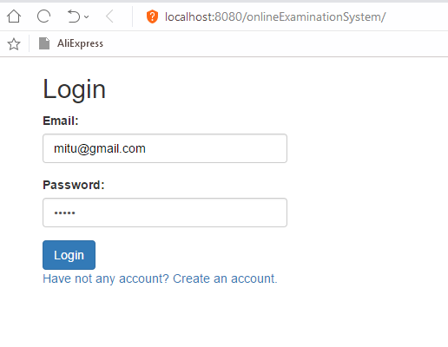
When a user click on Log in our site. The following page will be shown:

Slide 10
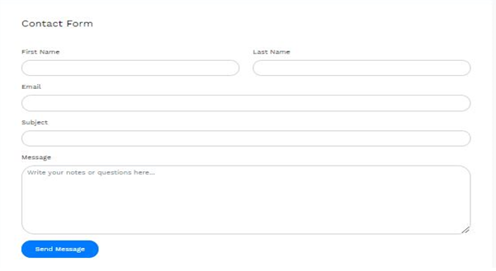
If any user will want to contact with us, he/she can click on Contact Us Bar and the following page will be shown:

Slide 11
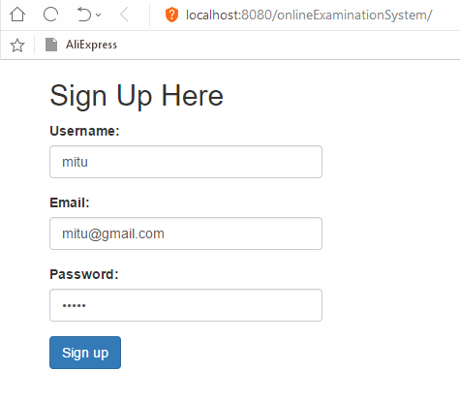
At first a student should sign up to this application. After completing the registration form, he must click on the register button.

Slide 12
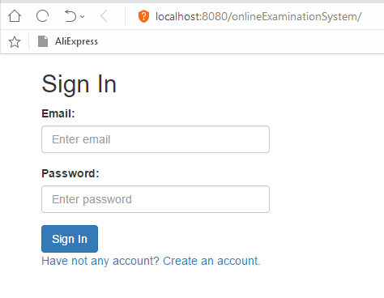
Then the student is enlisted to the Database of the online exam where he can participate for the exam and finally the applicant can get login and password to sit in the exam

Slide 13
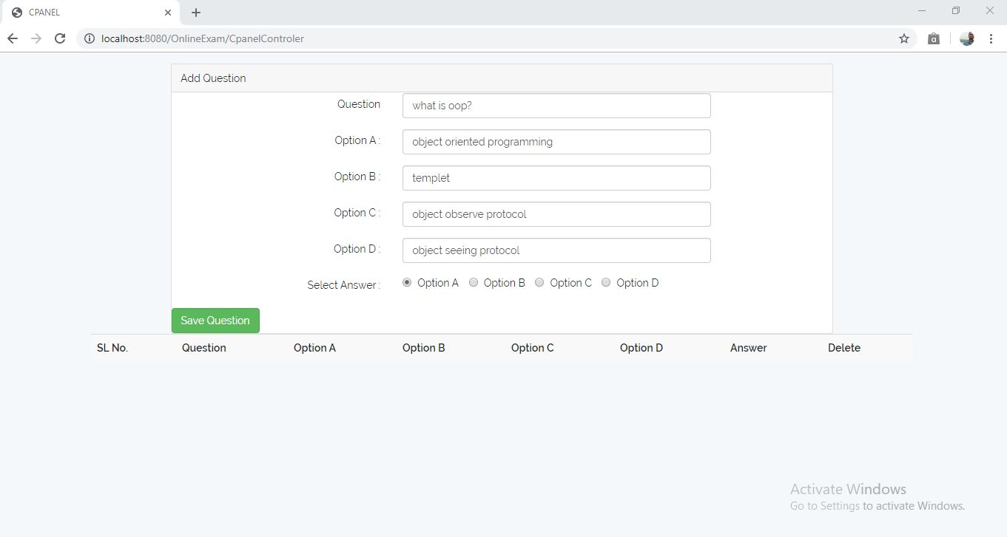
Student can insert questions and option a,b,c,d and the correct answer which is stored in the database

Slide 14
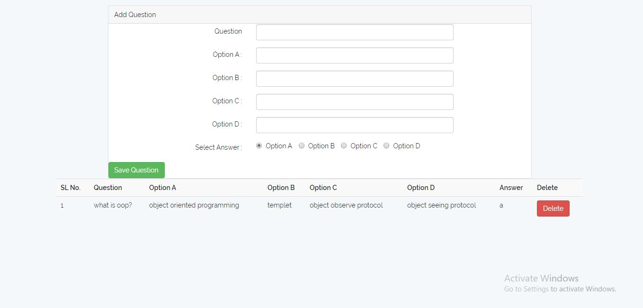
After clicking on the save Question button, then it will save in the database. The question and option can see the question paper and other things preserved in the control panel

Slide 15
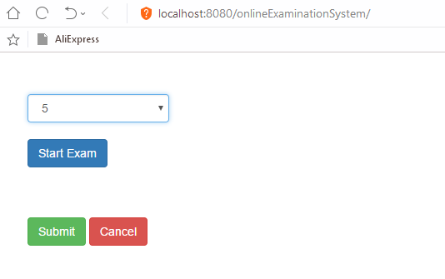
Then he gets the ques. paper and option of the ques. where he chose his desirable option and submit it by completing all the answers and he will notify for that no. of correct and incorrect answer
Start Exam

Slide 16
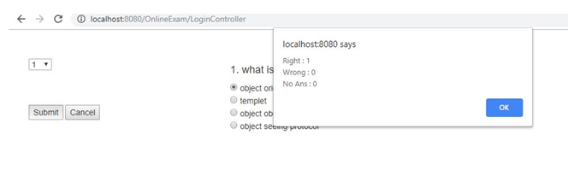
Result

Slide 17
Conclusion
We are confident that this online quiz system website will be helpful to a students in real life. Also developing their skill. And we hope we will make it better to use in future.

Slide 18


